Slide 1
Milestone 1
Team 6
Apps Linking Midshipmen and Officers

Slide 2
Project Management
Functional Requirement Table
Meeting Summary
Workload Matrices
Gantt Chart

Slide 3
Functional Requirements
Functional Requirement | Acceptance Test Plan
Secure Log-In for each user | 1.1 Every user must be able to correctly log in with their credentials. (Normal) 1.2 Users only see information pertinent to them when they log in (Normal) 1.3 Users cannot log in without proper username or password (Abnormal)
2. Data-Updates with Local Changes | 2.1 Proper amount of currently available funds are displayed. (Normal) 2.2 When an inquiry is cleared the proper amount of money is reflected in the account. (Normal) 2.3 Completed transactions from the fiscal year with job number are displayed. (Normal) 2.4 The system would display negative money for a user that has overspent their grants. (Abnormal)

Slide 4
Functional Requirements, cont.
Functional Requirement | Acceptance Test Plan
3. Validated data entry for Ms. Schroeder | 3.1 Ms. Schroeder has an easy and efficient to enter faculty expenses into the database. (Normal) 3.2 Ms. Schroeder can enter expenses for any faculty account. (Normal) 3.3 Ms. Schroeder would be prevented from entering more money than a faculty member had available. (Abnormal)
4. Proper Logout | 4.1 When a user clicks the logout button, their session is ended. (Normal) 4.2 The session info is not saved on the client’s browser when logout is selected (Normal) 4.3 The session is ended when the browser is closed because of sensitive personal information (Abnormal)

Slide 5
Functional Requirements
Functional Requirement | Acceptance Test Plan
5. Pull from Fast-Data System | 5.1 Get proper connection to USNA’s finance database (Normal) 5.2 A user’s information is searched when their work order number is entered (Normal) 5.3 No order will display when the incorrect order number is entered (Abnormal)
6. Data Transfer | 6.1 Information is transferred between the client and our website. (Normal) 6.2 Information that is improperly formatted should not be sent (Abnormal)
7. Concurrent and Secure Database interaction | 7.1 Data is encrypted if there happens to be an intruder watching data move between endpoints (Abnormal) 7.2 Queries are guaranteed to be concurrent using structured Transactions in MySQL (Normal)

Slide 6
Functional Requirement | Acceptance Test Plan
8. Properly navigable web pages | 8.1 - When you click a link to another page on the site you are properly rerouted to that page (normal) 8.2 - When a page does not exist an error page is presented (abnormal)
9. Informational and useful log files | 9.1 - Throughout user's interactions with site their actions are securely logged (normal) 9.2 When a user continuously resubmits a form identical messages are not generated (abnormal)
10. Only admin can access admin page | 10.1 - When an admin logs in, they have access to admin page (normal) 10.2 - Disallow forced entry to admin page from unauthorized user (abnormal)

Slide 7
Meeting Summary - Professor Malek-Madani
Two databases
Stars-fl - Official database
Fast-data - Between Academy and comptroller
Software to communicate with these databases
Would potentially need access to one or both of these databases
Desired state: Automatic way for faculty to access their statements

Slide 8
Meeting Summary
Currently turn-around time of ½ week for faculty requests
Would like quicker response to faculty requests for account balance
All liaised through Jean Schroeder.
All information currently hand entered into excel.

Slide 9
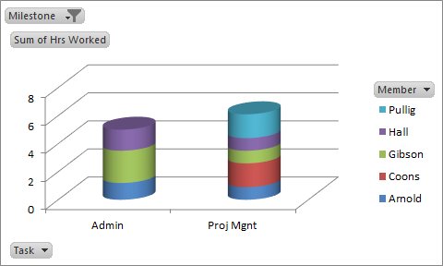
Workload Summaries

Slide 10
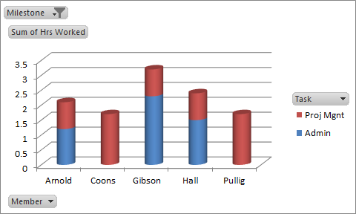
Milestone Specific Task-Oriented

Slide 11
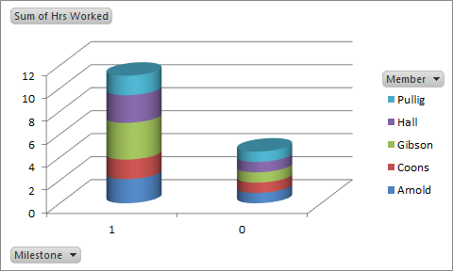
Cumulative Member-Oriented

Slide 12
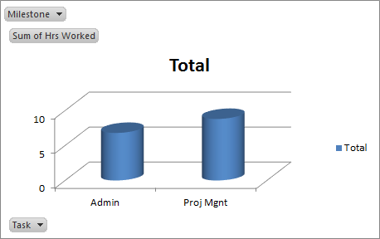
Cumulative Task Oriented

Slide 13
Team 6
NOV
DEC
JAN
FEB
7
14
21
28
5
12
19
26
4
11
18
25
6
13
20
27
% complete
Mile 1: Secure Log-In
0
Mile 2: Database Access
0
Mile 3: Secure Data Entry
0
Mile 4: Faculty Access
0
Mile 5: Alpha Testing
0
Planned:
Actual:
Notes:
Mile 5 = all of feb,
Mile 4 = all of jan
Mile 3 = dec 12- end of dec
Mile 2 = 21 nov start of mile 3
Mile 1 = the rest

Slide 14
Modeling
Prototype
Paper Presentation

Slide 15
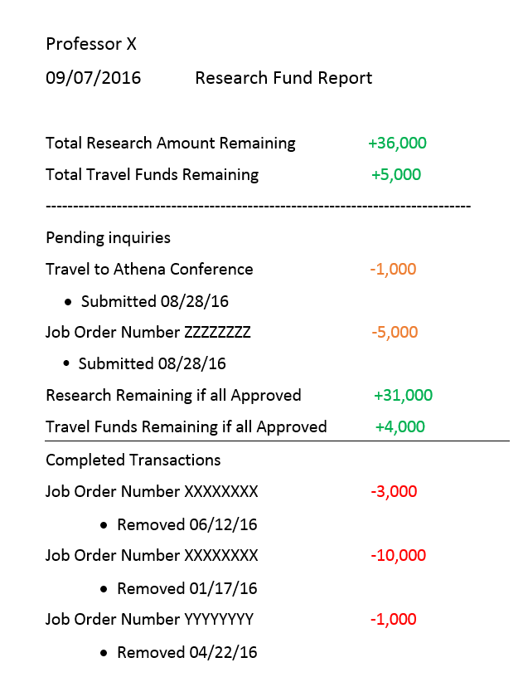
Report Prototype
Modeled to take after a traditional bank statement
Easy to read
Only pertinent information

Slide 16
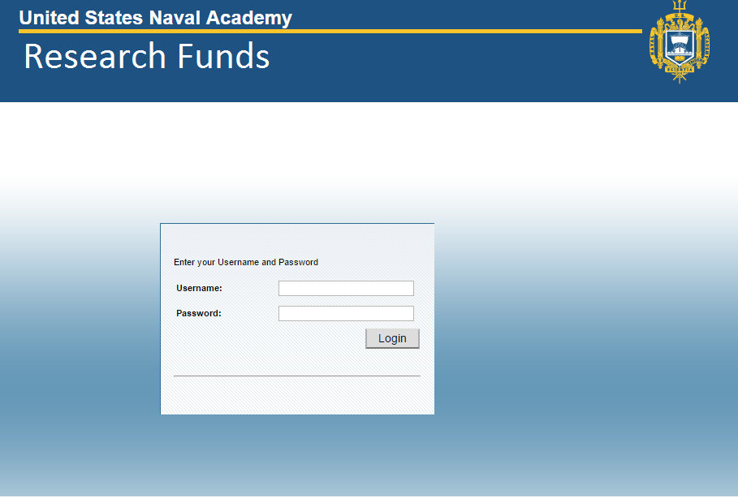
Login Prototype
Standard Academy
login page

Slide 17
Therac-25
N. Leveson, “Medical Devices: The Therac-25”
Appendices 1-4

Slide 18
The Dangers of Software
Always prepare for worst case circumstances
Do not be single point of failure
Always keep error reports in logs

Slide 19
Background
Radiation machine for tumor removal
Two previous iterations that used hardware fail-safes
Therac-25 used only software fail-safes

Slide 20
Background
Therac-25 reused much software from previous iterations
The machine’s software was not analyzed in the Hazard Analysis
User input was simplified and required no double checking

Slide 21
Worst Case
When developing mission or health critical software you must always prepare for the worst case. The Therac-25 was numerous times by the manufacturer, but only with cases that the machine expected. Radiation exposure and saturation were not taken into account, and because of this a malfunction occurred.

Slide 22
Lack of Fail-safes
In the case of Therac-25, the fail-safes were sparse if present at all.
For Example: The machine relied solely on the software to move the hardware in the correct position and orientation to administer the therapy. The machine output a very high intensity beam of electrons that was required to be attenuated by hardware. There were no checks in place to verify the “flattener” was in place before delivering the beam of radiation to the patient.

Slide 23
Error Reports
After a few people were injured by the Therac-25 an investigation was opened to determine what caused the problem. However, even though there was multiple warnings that there may be a problem with the software, none of the errors were logged. Because there weren’t any errors logged the investigation blamed a faulty switch and more people were injured.

Slide 24
Conclusion
When designing mission critical software, it is necessary to take into account extreme scenarios. There should be a plan of action for every situation possible.
Documentation is essential. It should be easy enough for the average user to understand the inevitable malfunction while being thorough enough to adequately describe the problem.
Never become complacent in your work. Sacrificing safety for ease-of-use should not be tolerated. There should be proper risk-assessment for all aspects of software and hardware interaction.

